Slide 1

Contact Center WFM Diagnostic
Senior Workforce Management, Operations Analytics & Business Intelligence Assessment
ANALYSIS WINDOW: 2026-07-20 TO 2026-07-26
PREPARED: 2026-07-28

Slide 2

Executive Summary
Forecast volume is directionally strong, but service performance is below target and interval-level execution is uneven. A net staffing surplus of +30.2 agents coexists with 46 understaffing events — timing mismatch, not headcount shortage.
Service Level
72.1% vs. 80% target
ASA
39.3s weighted average
Forecast WAPE
4.9% — strong aggregate
Staffing Gap
+30.2 agents average surplus

Slide 3

Executive Dashboard
151,840
4.9%
Total Actual Calls
Forecast WAPE
7-day observed window
Lower is better; strong aggregate
13.4%
72.1%
Forecast MAPE
Service Level
Interval-level error volatile
Below 80% target
39.3s
+30.2
ASA
Mean Staffing Gap
Weighted speed of answer
Scheduled minus required agents
Overall health: 6.0/10 — forecast quality good, service performance at risk. Data quality: 98.8/100.

Slide 4
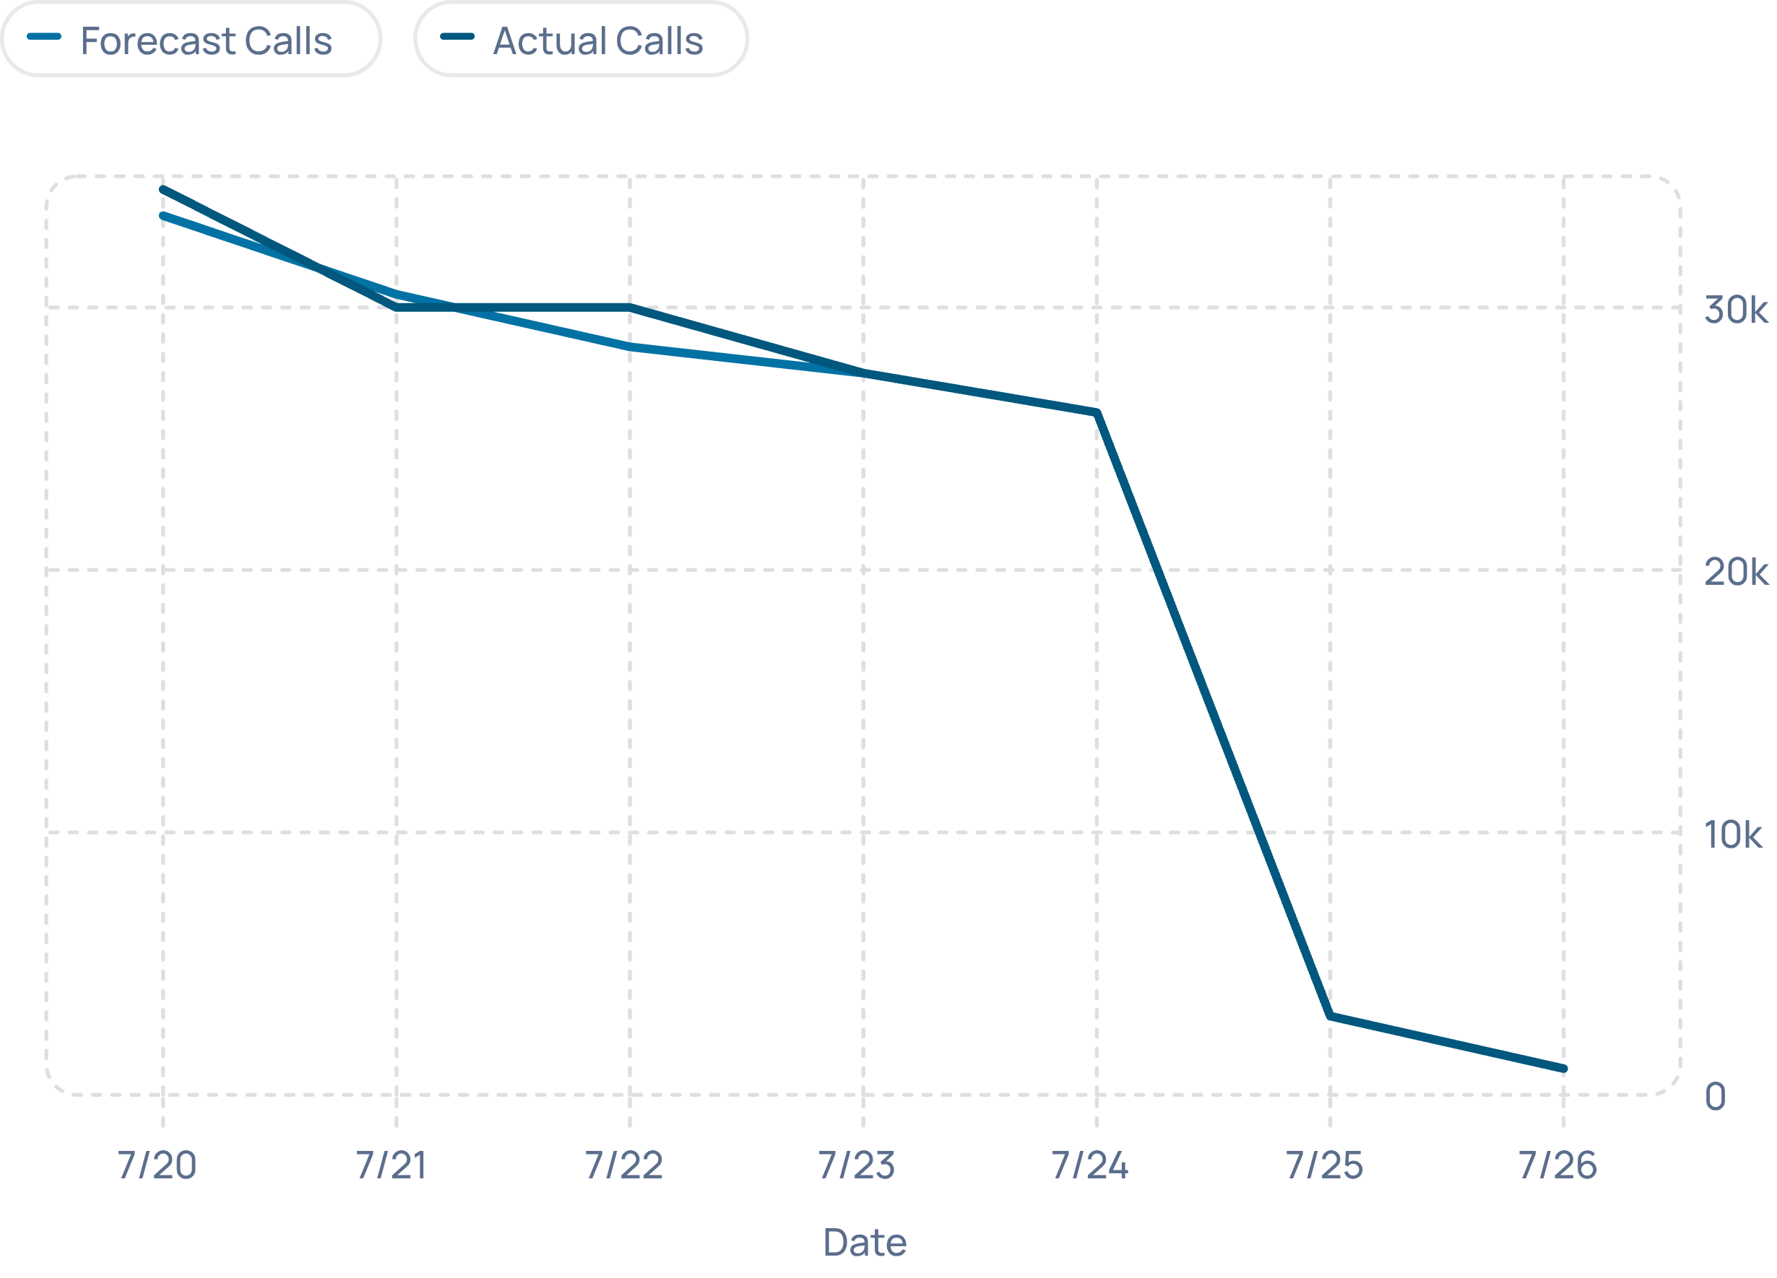
Daily Contact Volume — Actual vs Forecast
Volume Trend
Actual volume exceeded forecast on select days. A sharp weekend drop drives the moving average down. Forecast tracks the trend but interval-level errors remain material.
Service Level Trend
Service level rose from 60% to 94% across the week but averaged 72.1% — below the 80% target. ASA fell from 65s to 15s, averaging 39.3s vs. a ≤30s target.

Slide 5
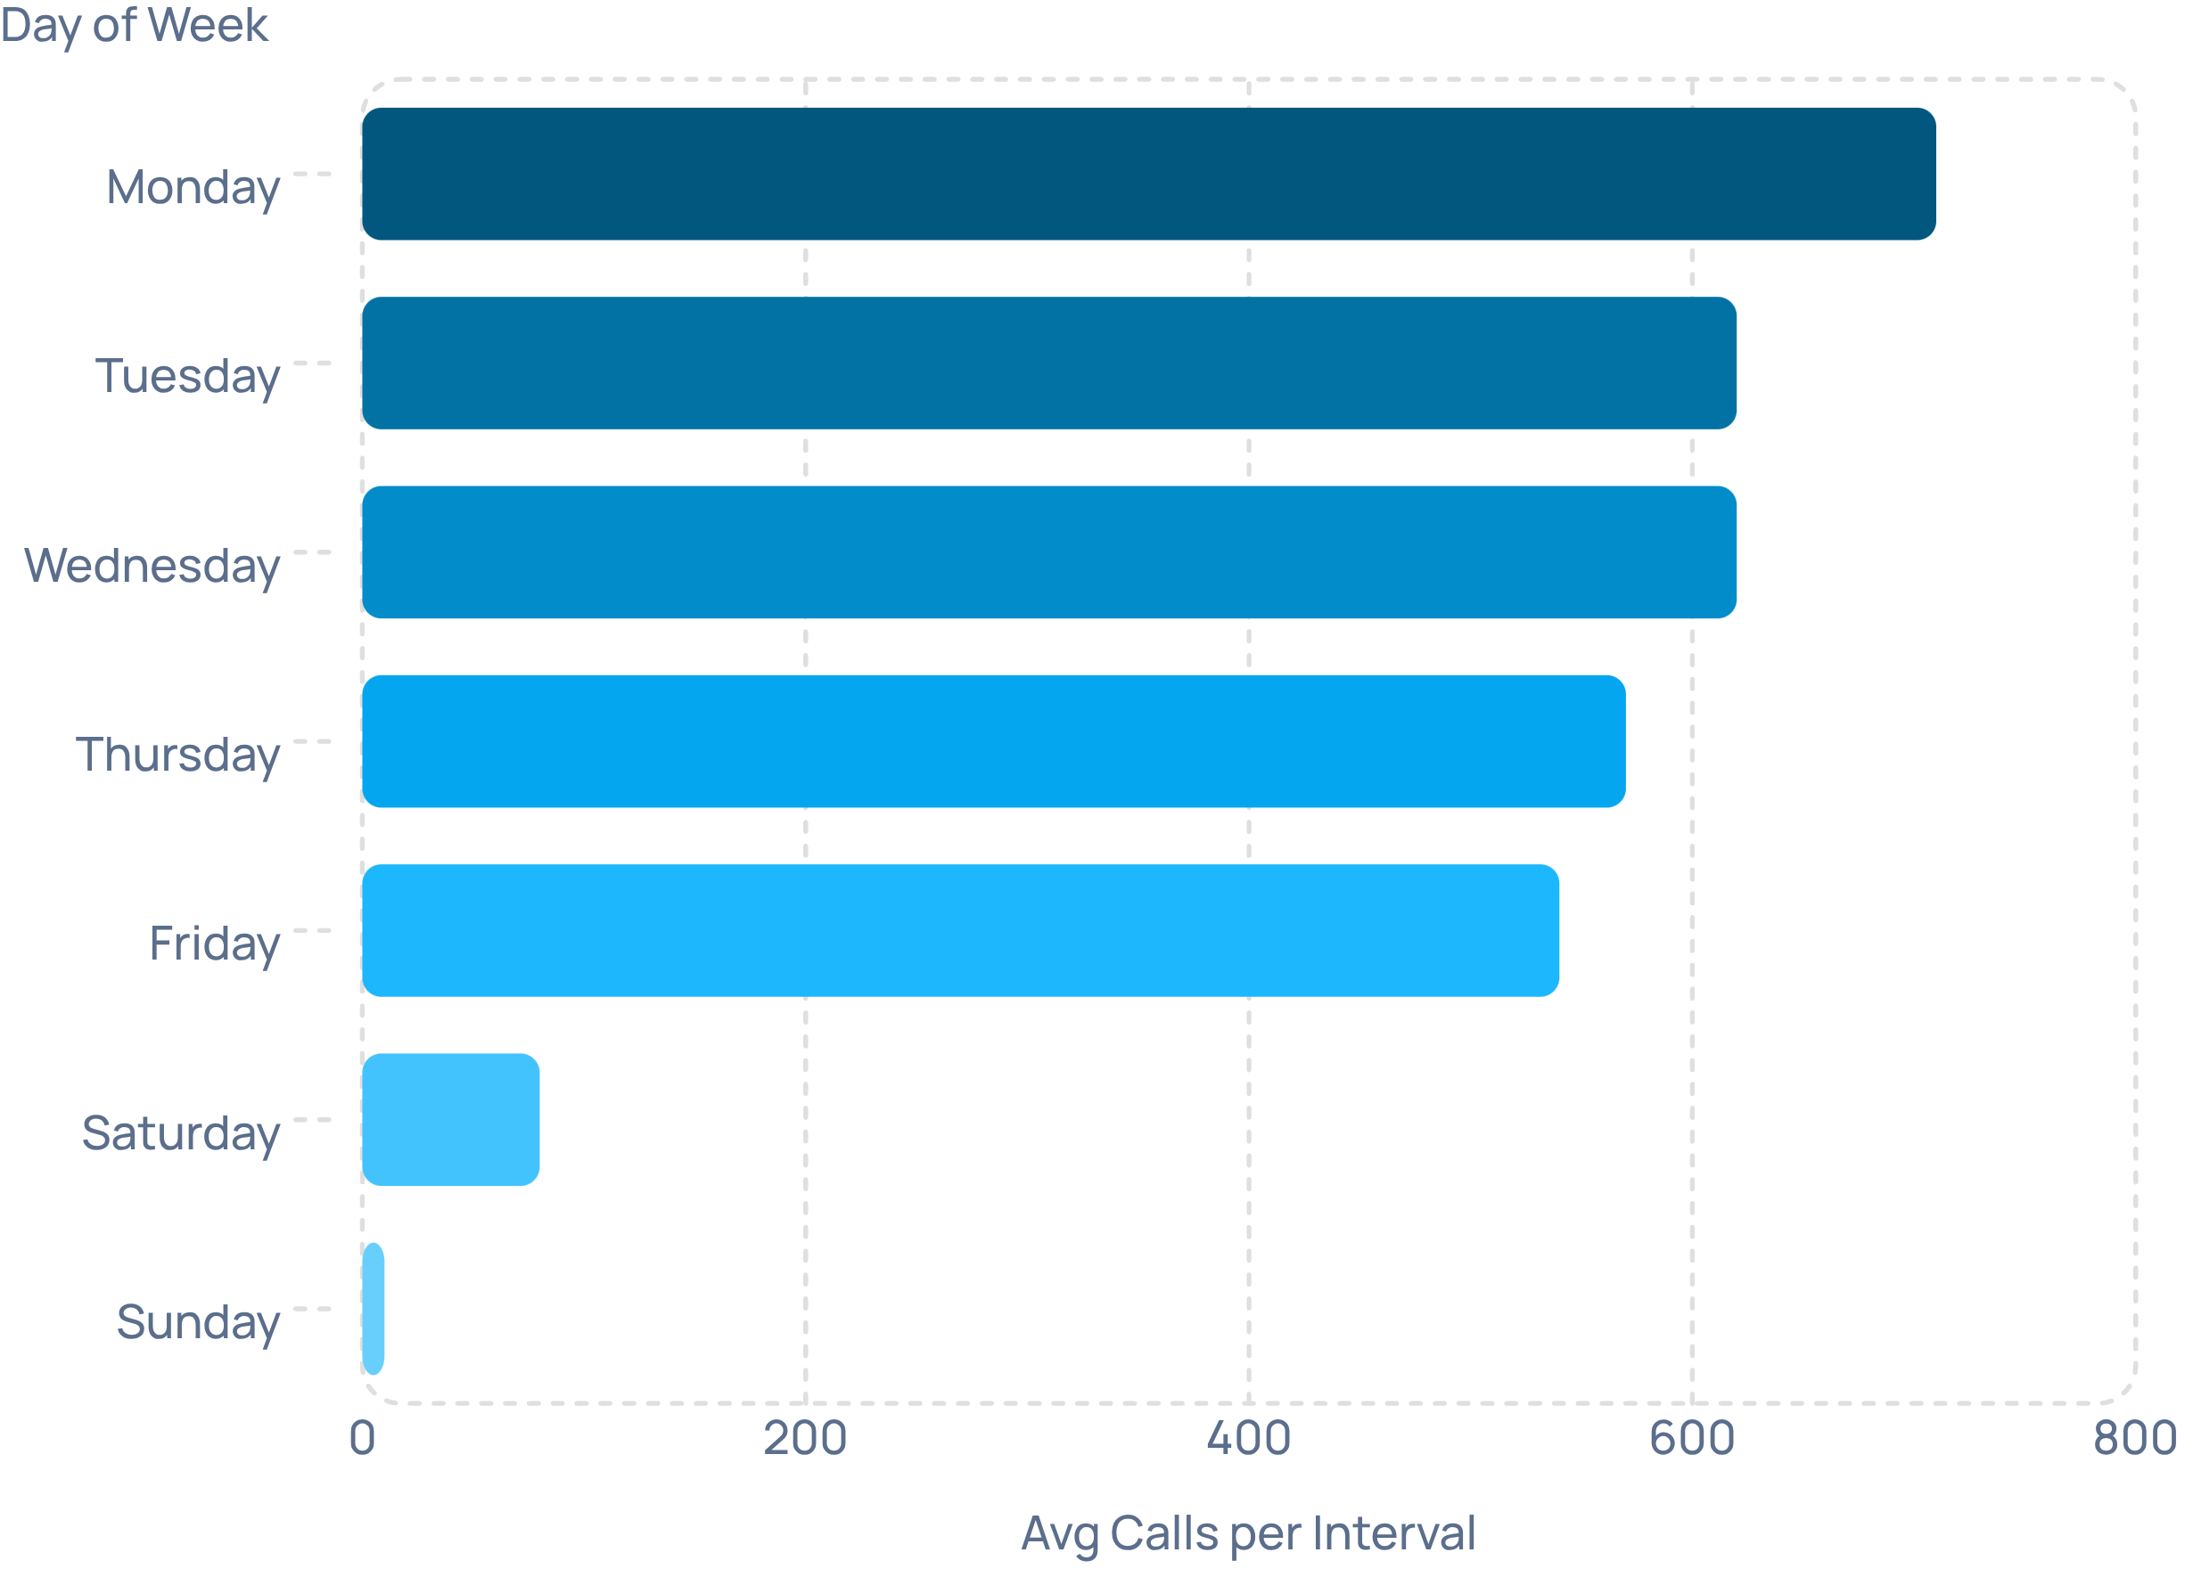
Call Volume & Data Quality
Day-of-Week Volume
Monday peaks at ~710 avg calls/interval; weekends are negligible. Use day-of-week weighting in schedules, but avoid seasonal conclusions until 13+ weeks are available.
Peak Interval
Highest observed average: 11:30 at ~694 calls. Daily median volume: 27,500 calls (IQR: 14,500–30,000).
Data Quality
313 rows, 22 columns, 98.8/100 score. 65 nulls of 6,886 cells. No stable primary key — use date + interval.

Slide 6


Forecast Assessment
Forecast vs. Actual
Aggregate WAPE is 4.9% but MAPE is 13.4% — low-volume intervals carry high relative error. Tracking signal of 121.4 indicates persistent under-forecasting. Forecast bias of +1.9% confirms actual exceeded forecast in aggregate.
Error Profile
MAE: 24.2 calls per interval
RMSE: 33.9 calls — large misses cost more
95% CI for signed error: −10.9% to −2.6%
Use error timeline to set intraday reforecast triggers and bias corrections.

Slide 7
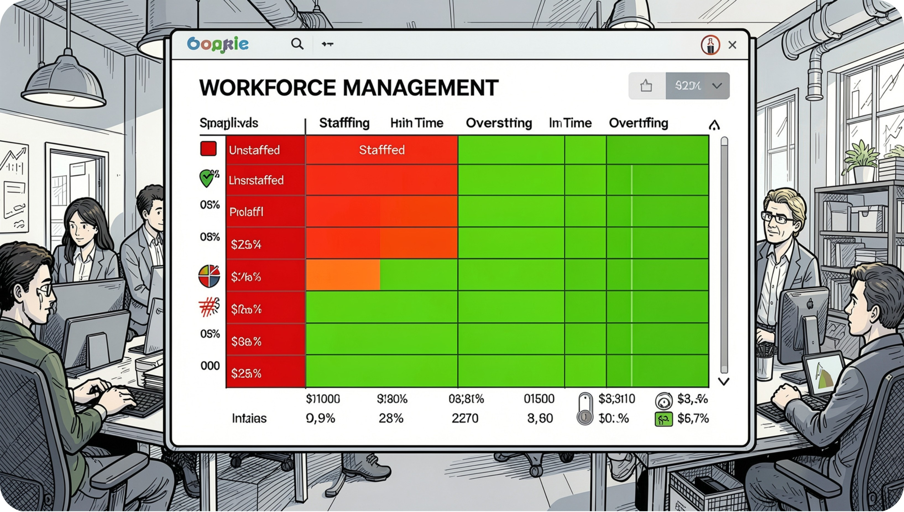
Staffing Analysis
Staffing Gap vs. Service Level
Positive association: as staffing gap increases, service level improves. Correlation is statistically significant (r=0.62, p<0.001) but causality is not proven.
Key Findings
Mean required: 308.4; mean scheduled: 338.7
46 understaffed intervals — immediate action needed
262 overstaffed intervals — redeployment windows
Move capacity across intervals before adding headcount.

Slide 8
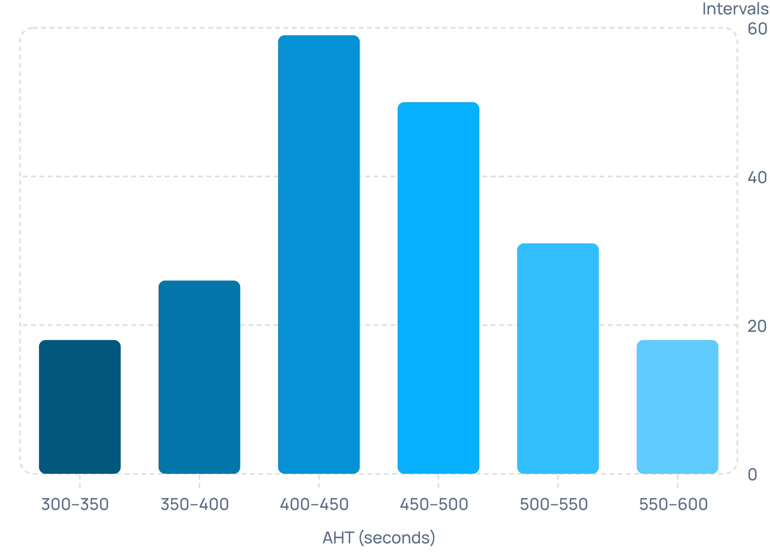
AHT Distribution & Service Level
AHT Profile
Average AHT: 431s (median 433s, P95: 502s, P99: 546s). The right tail represents disproportionate capacity consumption — prioritize P95/P99 workflows for automation.
Service Level Evidence
Staffing gap / service level correlation: r=0.62, p=1.05e-34. Supports interval rebalance, but validate with queue-level controls.
Data Gaps
No occupancy, shrinkage, adherence, repeat-contact, or transfer fields. Integrate NICE/Verint/Five9 agent-state data to calculate certified KPIs.

Slide 9
Business Impact & Risk
16,071
$401K
7.7
Annual Hours at Risk
Annual Cost Exposure
FTE Equivalent
Illustrative annualization of understaffed intervals
Based on $25/hour loaded labor rate
Directional estimate only
Top Risks
Top Opportunities
Service level below target — High
Limited historical depth — High (1 week only)
Forecast volatility — Medium
Staffing hotspot masking — Medium
AHT tail — Medium
Interval staffing rebalance — 0–30 days
Forecast bias correction — 0–30 days
Intraday playbook — 0–30 days
AHT tail reduction — 31–90 days
Hierarchical forecast model — 90+ days

Slide 10


Executive Roadmap
1
0–30 Days
Launch interval staffing heatmap and intraday reforecast trigger. Apply day/interval forecast bias correction. Reduce understaffed intervals; improve SL and ASA.
2
31–90 Days
Build root-cause taxonomy for AHT and repeat contacts. Integrate schedule events and agent states for certified occupancy, shrinkage, and adherence.
3
90+ Days
Deploy backtested hierarchical forecast model by queue and interval. Stand up executive dashboard with alerts and ROI tracking.
Key Limitations: 7-day window; no queue/skill/agent/transfer/repeat-contact/shrinkage fields. ML requires 13–26 weeks. Governance: daily intraday, weekly forecast, monthly benefits review.

